Slide 1
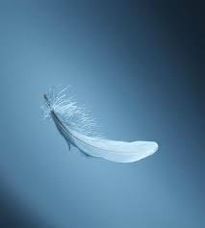

Slide 2
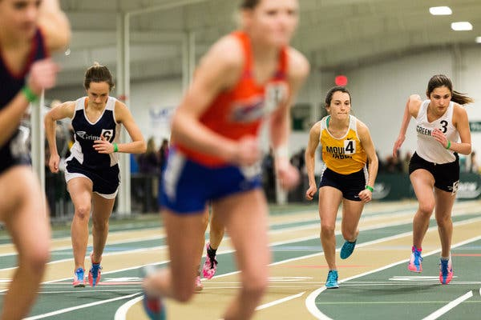
“I have to trust that my legs will take me to the end even though I can’t feel them-I just keep going!”

